Slide 1
Describing a distribution of a score

Slide 2
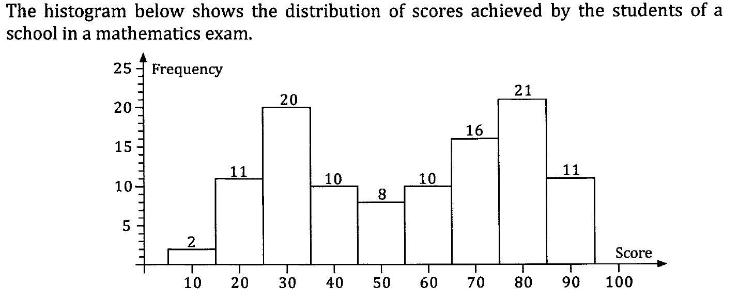

Slide 3
Description
Location – mean and median
Spread – Range of scores gives information about their spread
Shape – symmetry, gaps, more/less dense regions, outliers, modality, convey information about the shape of a distribution
Anything else of relevance

Slide 4
Use words such as
Lowest score
Highest score
Gaps
Tightly packed
Spread out
Clusters
Groups
Symmetrical
Outliers
Uniform

Slide 5
Relevant information
One hundred and nine (109) students from the school sat the examination.

Slide 6
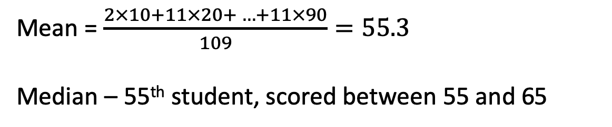
Location
Mean
Median
Mean = $\frac{2×10+11×20+ …+11×90}{109}=55.3$
Median – 55th student, scored between 55 and 65

Slide 7
Spread
Range: 95 – 5 = 90

Slide 8
Shape
Spread reasonably symmetrical
Bi-modal, peak around 30 and again at 80

Slide 9
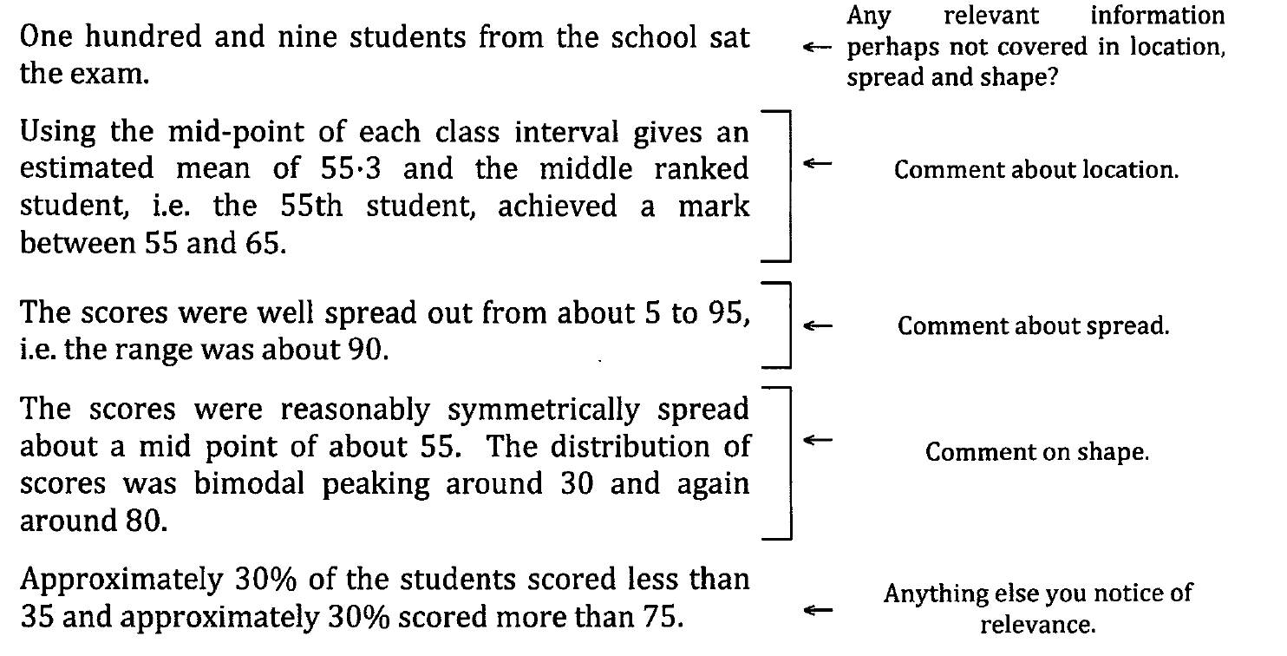

Slide 10
109 students
Mean = 55.3
Median = between 55 an 65
Range 90
Symmetrical
Bimodal

